Slide 1
Flow of food product

Slide 2
LEARNING OUTCOME
In this chapter, information will be presented about:
• Unique characteristics of foodservice
• Flow of food
• Form of food purchased
• Types of foodservice systems
⇒ Conventional
⇒ Centralized (Commissary)
⇒ Ready-Prepared
⇒ Assembly-Serve
• Advantages and disadvantages of each type of foodservice system

Slide 3
food product flow
the alternative paths within a foodservice operation that food and menu items may follow, initiating with receiving and ending with service to the customer

Slide 4
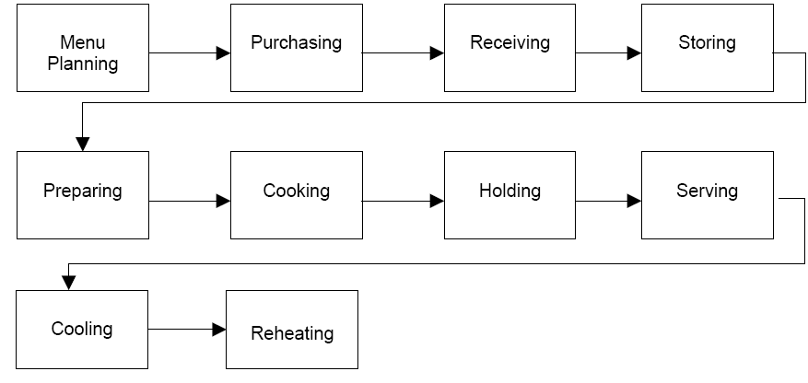
Flow of food

Slide 5
types of foodservice based on production
conventional,
Commissary (centralize),
ready prepared,
Assembly serve.

Slide 6
1)characteristics of conventional foodservice
foods purchased in various stages of prep; production, distribution & service completed on same premise;
foods are held hot or cold and served as soon as possible
Eg :independent restaurants, schools/colleges, hospitals/health care facilities, in-plant employee feeding

Slide 7
advantages vs. disadvantages of conventional foodservice
quality control, adaptability, flexibility, minimal freezer storage space & distribution costs vs. meal period demands/stressful workday, varying work days creates suffering productivity, difficulty scheduling workers (overlapping shifts)

Slide 8
characteristics of ready prepared foodservice
foods purchased like conventional but menu items are produced & held chilled/frozen until heated for serving (not immediate); 2 different inventories (storage upon receipt, distribution upon production chilling); HACCP required; readily available menu items at any moment

Slide 9
methods used in ready prepared foodservice
cook-chill (partial cooking, rapid chilling, held, then reheated); cook-freeze (partial cooking, rapid freezing, held then reheated); enhancements --> sous vide (food sealed in plastic pouches & chilled, reheated in boiling water), capkold (food cooked high temp, sealed in plastic, chilled w/o further heat treatment); retort (special pouches to withstand temp & pressure of retort

Slide 10
advantages vs. diasadvantages of ready prepared foodservice
minimally skilled employees (reduces production labor costs), increased consistency in quality of products, balanced equipment use, menu variety, managerial control vs. food safety & quality concerns w/ reheating, requires special space- and energy-consuming, expensive equipment to chill/freeze

Slide 11
examples of ready prepared foodservice
large volume institutions, centralized commissary chain set ups, airlines, correctional institutions, supermarkets, quick service restaurants (not really schools, hospitals)

Slide 12
characteristics of commissary foodservice
centralized procurement/production facilities w/ distribution of prepared menu items to remote areas for final prep & service (central commissaries vs. satellite service centers); storage occurs in bulk or individual portions

Slide 13
advantages vs. disadvantages of commissary foodservice
cost savings (large-volume purchasing, reduced duplication of labor/equipment), increased supplier competition & cooperation, volume discounts, high efficiency vs. control of packaging & storage of food, specialized equipment for packaging/storing/distributing, food safety in transportation, high initial costs of constructing commissaries & purchasing transportation equipment; highly skilled personnel

Slide 14
examples of commissary foodservice
schools, and secondary schools often serve as the base for distributing out to elementary schools; also, airline caterers, franchised/chain restaurant organizations, vending companies

Slide 15
characteristics of assembly/serve foodservice
when menu items are purchased already prepared, requiring minimal cooking before service (no onsite food production; kitchenless kitchens); only storage, assembly, heating & service performed here

Slide 16
advantages vs. disadvantages of assembly/serve foodservice
built in labor savings (dec personnel & skill), lower procurement costs, minimal equipment & space requirements, reduced OC for gas, electricity and water vs. availability of foods for modified diets (limited menu & regional appeal), lack of individuality, increased freezer/storage requirements

Slide 17
examples of assembly/serve foodservice
hospitals, healthcare institutions, restaurants

Slide 18
centralized vs. decentralized service
when plates or trays are assembled in an area close to production before being distributed vs. when food is distributed in bulk quantities for tray assembly in an area close to service (ie galley in hospital wing); combo is used; associated with conventional

Slide 19
reference
http://nfsmi.org/documentlibraryfiles/PDF/20080212032530.pdf
Unklesbay, N.F., Maxcy, R.B., Knickrehm, M.E., Stevenson, K.E., Cremer, M.L.,& Matthews, M.E. (1977). Foodservice systems: Product flow and microbial quality and safety of foods. (North Central Regional Research Publication No.245). Columbia, MO: University of Missouri-Columbia College of Agriculture,Agriculture Experiment Station.
Unklesbay, N. (1977). Monitoring for quality control in alternate foodservice systems. Journal of the American Dietetic Association, 71, 423-428.

